Slide 1

Data Structures: Linked Lists
Dr. Murali Krishna Enduri
Department of CSE

Slide 2
Linked List Basics
Linked lists and arrays are similar since they both store collections of data.
The array's features all follow from its strategy of allocating the memory for all its elements in one block of memory.
Linked lists use an entirely different strategy: linked lists allocate memory for each element separately and only when necessary.
Linked lists are appropriate when the number of data elements to be represented in the data structure at once is unpredictable.
Linked lists are dynamic, so the length of a list can increase or decrease as necessary.
Each node does not necessarily follow the previous one physically in the memory.
Linked lists can be maintained in sorted order by inserting or deleting an element at the proper point in the list.

Slide 3
Linked Lists
Single Linked Lists
Double Linked Lists
Circular Linked Lists
Traversing
Search
Insertion
Deletion

Slide 4
Linked Lists
A
B
C
\0
Head
A linked list is a series of connected nodes
Each node contains at least
A piece of data (any type)
Pointer to the next node in the list
Head: pointer to the first node
The last node points to NULL
node
A
data
pointer

Slide 5
Singly Linked Lists
head
next
next
next
next
20
5
15
17
\0
First node
Last node
head
Data
next

Slide 6
Create a Linked List
Empty Linked list is a single pointer having the value of NULL.
head = NULL;
head
Let’s assume that the node is given by the following type declaration:
struct Node{
int data;
struct Node *next;
};
head
Data
next
To start with, we have to create a node (the first node), and make head point to it.
head = (struct Node*)malloc(sizeof(struct Node));

Slide 7
#include<stdio.h>
#include<stdlib.h>
Creating the linked List
struct Node {
int data;
struct Node *next;
};
struct Node *create_list();
void display(struct Node *);
struct Node *create_list()
{
int k, n;
struct Node *p, *Head;
printf("\n How many elements to enter?");
scanf("%d", &n);
for (k=0; k<n; k++)
{
if (k == 0) {
Head = (struct Node*)malloc(sizeof(struct Node));
p = Head;
}
else {
p->next = (struct Node*)malloc(sizeof(struct Node));
p = p->next;
}
printf("\n Enter an %dth element",k);
scanf("%d",&p->data);
}
p->next = NULL;
return(Head);
}
void main()
{
struct Node *head;
head=create_list();
display(head);
}
void display (struct Node *head)
{
struct Node *p;
for(p = head; p!= NULL; p = p->next)
{
printf ("\nNode data %d", p->data);
}
printf ("\n");
}

Slide 8
Basic Linked List Operations
List Traversal (Display function)
Searching an element in a linked list
Insert a node (At begin, At end , In between)
Delete a node (At begin, At end , In between)

Slide 9
Traversing a linked list
void display (struct Node *head)
{
struct Node *p;
int count=0;
for(p = head; p!= NULL; p = p->next)
{
printf ("\nNode data %d", p->data);
count=count+1;
}
printf ("\n");
}
head
20
5
15
17
\0

Slide 10
Searching an element in a linked list
void search(struct Node *head)
{
struct Node *p;
int key, flag=0;
printf(“Enter an element to search:”);
scanf(“%d”,&key);
for(p = head; p!= NULL; p = p->next)
{
if ((p->data)==key)
{
flag=1; break;
}
}
if(flag==1)
printf(“found”);
else
printf(“not found”);
}
void main()
{
struct Node *head;
head=create_list();
display(head);
search(head);
}
head
20
5
15
17
\0

Slide 11

Insert a node At beginning
Steps:
Create a Node
Set the node data Values
Connect the pointers
head
48
17
142
\0
Follow the steps and we get
Step 1
Step 2
Step 3
head
93
48
17
142
\0

Slide 12
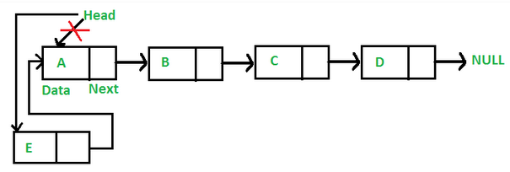
Insert a node At beginning of Linked List
struct Node *insertB(struct Node *head)
{
/* 1. create a new node */
struct Node* newnode;
newnode = (struct Node*) malloc(sizeof(struct Node));
/* 2. put in the data */
printf(“Enter an element to insert at beginning:”);
scanf(“%d”,&newnode->data);
/* 3. Make next of new node as head */
newnode->next = head;
/* 4. move the head to point to the new node */
head=newnode;
return(head);
}
void main()
{
struct Node *head;
head=create_list();
head=insertB(head);
display(head);
}

Slide 13

Insert a node At end of Linked List
Steps:
Create a Node
Set the node data Values
Connect the pointers
head
48
17
142
\0
Follow the steps and we get
Step 1
Step 2
93
\0
Step 3
93
\0

Slide 14
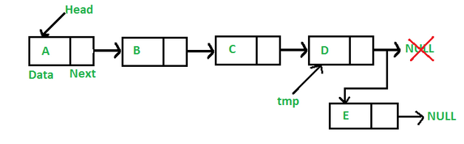
Insert a node At end of Linked List
struct Node * insertE(struct Node *head)
{
/* 1. create new node */
struct Node* newnode;
newnode = (struct Node*) malloc(sizeof(struct Node));
/* 2. put in the data */
printf(“Enter an element to insert:”);
scanf(“%d”,&newnode->data);
/* 3. This new node is going to be the last node, so make next of it as NULL*/
newnode->next = NULL;
/* 4. If the Linked List is empty, then make the new node as head */
if (head== NULL)
{ head = newnode;
return(head); }
/* 5. Else traverse till the last node */
struct Node *p=head;
while (p->next != NULL)
{ p = p->next; }
/* 6. Change the next of last node */
p->next = newnode;
return(head);
}
void main()
{
struct Node *head;
head=create_list();
head=insertE(head);
display(head);
}

Slide 15

Insert a node At middle of Linked List
Steps:
Create a Node
Set the node data Values
Break pointer connection
Re-connect the pointers
head
48
17
142
Step 1
Step 2
Step 3
142
\0
Step 4
142
\0

Slide 16
Insert a node At middle of Linked List
Steps:
Create a Node
Set the node data Values
Break pointer connection
Re-connect the pointers
…
17
143
…
P
93
new_node
newnode = (struct Node*) malloc(sizeof(struct Node));
scanf(“%d”,&newnode->data);
newnode->next = p->next;
p->next = newnode;

Slide 17
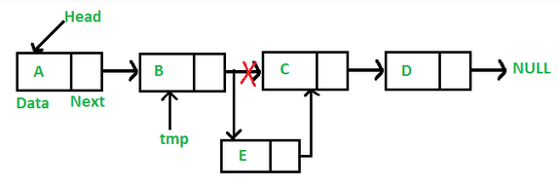
Insert a node At middle of Linked List
struct Node * insertM(struct Node *head)
{
int newdata, loc=3,c=0;
/* 1. create a new node */
struct Node* newnode;
newnode = (struct Node*) malloc(sizeof(struct Node));
/* 2. put in the data */
printf(“Enter an element to insert:”);
scanf(“%d”,&newnode->data);
/* 3. If the Linked List is empty, then make the new node as head */
struct Node *p=head;
while(p!= NULL || c!=loc)
{ p = p->next;
c=c+1; }
/* 4. move the next of prev_node as new_node */
newnode->next=p->next;
p->next=newnode;
return(head);
}
void main()
{
struct Node *head;
head=create_list();
head=insertM(head);
display(head);
}

Slide 18
Delete a node At beginning of Linked List
head
Steps
Break the pointer connection
Re-connect the nodes
Delete the node
6
4
17
42
\0
head
6
4
17
42
\0
head
struct Node *DeleteB(struct Node *head)
{
If (head==NULL)
return(head);
head=head->next;
return(head);
}
4
17
42
\0
void main()
{ struct Node *head;
head=create_list();
head=DeleteB(head);
display(head);
}

Slide 19
Delete a node At end of Linked List
Steps
Break the pointer connection
Set previous node pointer to NULL
Delete the node
head
6
4
17
42
\0
head
struct Node *DeleteE(struct Node *head)
{
If (head==NULL)
return(head);
struct Node *curr, *prev;
for(curr=head; curr!=NULL;curr=curr->next)
{
prev=curr;
}
prev->next=NULL;
return(head);
}
6
4
17
42
\0
head
6
4
17
\0
void main()
{ struct Node *head;
head=create_list();
head=DeleteE(head);
display(head);
}

Slide 20
Delete a node At middle of Linked List
head
6
4
17
42
\0
head
6
4
17
42
\0
head
6
4
17
\0
Steps
Set previous Node pointer to next node
Break Node pointer connection
Delete the node

Slide 21
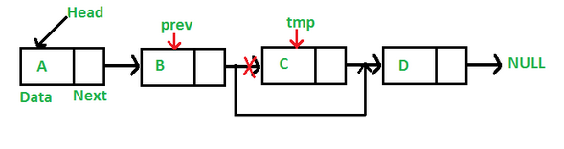
Delete a node At middle of Linked List
struct Node *DeleteM(struct Node *head)
{
int key;
printf(“Enter an element to delete:”);
scanf(“%d”,&key);
// Store head node
struct Node* curr = head, *prev;
// If head node itself holds the key to be deleted
if (curr!= NULL && curr->data == key)
{
head= curr->next; // Changed head
free(curr); // free old head
return(head);
}
while (curr != NULL && curr->data != key)
{
prev = curr;
curr = curr->next;
}
// If key was not present in linked list
if (curr == NULL) return(head);
// Unlink the node from linked list
prev->next = curr->next;
free(curr); // Free memory
}
void main()
{ struct Node *head;
head=create_list();
head=DeleteM(head);
display(head);
}

Slide 22
Doubly Linked Lists
head
\0
20
40
50
55
\0
Advantages:
Convenient to traverse the list backwards.
Simplifies insertion and deletion because you no longer have to refer to the previous node.
Disadvantage:
Increase in space requirements.
node
A
Lpointer
data
Rpointer

Slide 23
Create a Doubly Linked List
Empty Linked list is a single pointer having the value of NULL.
head = NULL;
head
Let’s assume that the node is given by the following type declaration:
struct Node {
int data;
struct Node *Rnext;
struct Node *Lnext;
};
head
Lnext
Data
Rnext
To start with, we have to create a node (the first node), and make head point to it.
head = (struct Node *)malloc(sizeof(struct Node));

Slide 24
#include<stdio.h>
#include<stdlib.h>
Creating the Doubly linked List
struct Node {
int data;
struct Node *Lnext;
struct Node *Rnext;
};
struct Node *create_list()
{
int k, n;
struct Node *curr, *post, *Head;
printf("\n How many elements to enter?");
scanf("%d", &n);
for (k=0; k<n; k++)
{
if (k == 0) {
Head = (struct Node*)malloc(sizeof(struct Node));
Head->Lnext=NULL;
curr = Head;
}
else {
post = (struct Node*)malloc(sizeof(struct Node));
curr->Rnext=post;
post->Lnext=curr;
curr=post;
}
scanf("%d",&curr->data);
}
curr->Rnext = NULL;
return(Head);
}
struct Node *create_list();
void display(struct Node *);
void main()
{
struct Node *head;
head=create_list();
display(head);
}
void display (struct Node *head)
{
struct Node *p;
for(p = head; p!= NULL; p = p->Rnext)
{
printf ("\nNode data %d", p->data);
}
printf ("\n");
}

Slide 25
Basic Doubly Linked List Operations
List Traversal (Display function) (Same as Single linked list)
Searching an element in a linked list(Same as Single linked list)
Insert a node (At begin, At end , In between)
Delete a node (At begin, At end , In between)

Slide 26
Insert a node At middle of doubly Linked List
head
current
newNode = (struct Node*)malloc(sizeof(struct Node));
newNode->Rnext = current->Rnext;
(current->Rnext)->Lnext=newnode
newNode->Lnext = current;
current->Rnext = newNode;
current = newNode;
newNode

Slide 27
Delete a node At middle of doubly Linked List
head
current
oldNode = current;
oldNode->Lnext->Rnext = oldNode->Rnext;
oldNode->Rnext->Lnext = oldNode->Lnext;
free(oldNode);

Slide 28
Circular Linked Lists
A Circular Linked List is a special type of Linked List
It supports traversing from the end of the list to the beginning by making the last node point back to the head of the list
A Rear pointer is often used instead of a Head pointer
10
20
40
55
70
head
10
head

Slide 29
#include<stdio.h>
#include<stdlib.h>
Creating Circular the linked List
struct Node {
int data;
struct Node *next;
};
struct Node *create_list();
void display(struct Node *);
struct Node *create_list()
{
int k, n;
struct Node *p, *Head;
printf("\n How many elements to enter?");
scanf("%d", &n);
for (k=0; k<n; k++)
{
if (k == 0) {
Head = (struct Node*)malloc(sizeof(struct Node));
p = Head;
}
else {
p->next = (struct Node*)malloc(sizeof(struct Node));
p = p->next;
}
scanf("%d",&p->data);
}
p->next = Head;
return(Head);
}
void main()
{
struct Node *head;
head=create_list();
display(head);
}
void display (struct Node *head)
{
struct Node *p;
printf ("\nNode data %d", head->data); for(p = head->next; p!= head; p = p->next)
{
printf ("\nNode data %d", p->data);
}
printf ("\n");
}

Slide 30
Insert to head of a Circular Linked List
New->next = head;
for(p=head->next;p->next!=head;p=p->next)
{}
p->next = New; // if p->next==head
head=new;
10
20
40
55
70
New
head
p
p
p

Slide 31
Insert to middle of a Circular Linked List between Pre and Cur
New->next = Cur;
Prev->next = New;
10
20
55
70
40
head
Prev
Cur
New

Slide 32
Delete the head node from a Circular Linked List
for(p=head->next;p->next!=head;p=p->next)
{}
p->next = head->next; // if p->next==head
head=head->next;
10
20
40
55
70
head
p

Slide 33
Delete a middle node Cur from a Circular Linked List
Prev->next = Cur->next;
free(Cur);
10
20
40
55
70
head
Prev
Cur

Slide 34
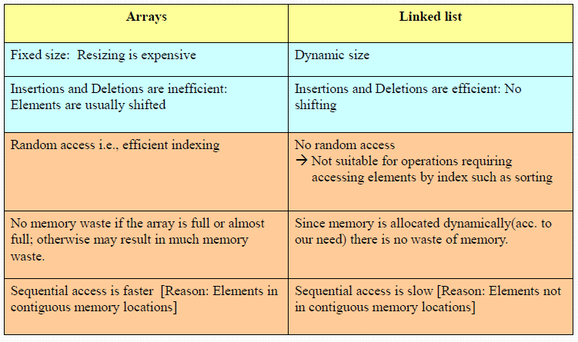
Arrays Vs Linked Lists

Slide 35
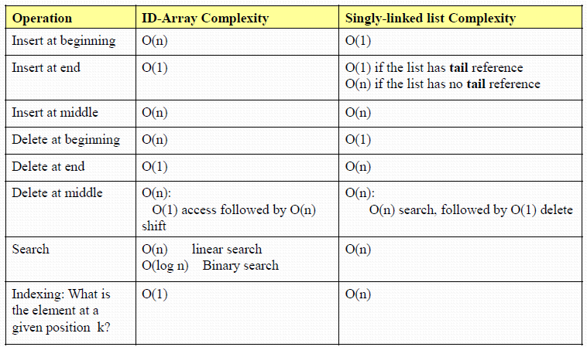
COMPLEXITY OF VARIOUS OPERATIONS IN ARRAYS AND LINKED LIST

Slide 36
Practice Problems on Linked List
Write a C program to create a single linked list with 5 nodes. (5 integers are taken from user input).
Write a C program to display a single linked list.
Write a C program to search an element a single linked list.
Write a C program to insert a node at beginning of a single linked list.
Write a C program to insert a node at end of a single linked list.
Write a C program to insert a node at middle of a single linked list.
Write a C program to create a doubly linked list with 5 nodes.
Write a C program to create a circular linked list with 5 nodes.
Write a C program to implement the stack using linked list.
Write a C program to implement the queue using linked list.

